Slide 1
SQL Server
What is SQL Server?
In all slides, db=database

Slide 2
What is SQL Server?
Correct pronunciation (see’ kwul)
Database storage technology based on the SQL programming language.
This is not Access!
Opposed to Access, Database size is only limited to the size of hardware. If you need more space, you just buy more hardware rather than new software.
Database backend

Slide 3
RDBMS
A database in the simplest form is a container storing data that people (or devices) can interact with
A short definition of a relational database management system(RDBMS) may be a DBMS (database management system) in which data is stored in the form of tables and the relationship among the data is also stored in the form of tables.
A RDBMS can store, manage and retrieve data.

Slide 4
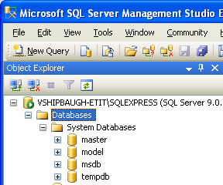
SQL Server
By default, SQL server is loaded with four system databases – which have to be installed for the server to run correctly:
  master
  model
  msdb
  tempdb

Slide 5
The master Database
The master database holds system tables that keep track of the system – such as all the databases that the server holds.
You should try to steer clear of the master db whenever possible.

Slide 6
The model Database
The model database forms a template for any new database that you create.
It is a standard on which to base all new databases.
Any database created has to be as large as the model database – so if the model db is 100MB, the new db cannot be smaller.
Notes:
You could add new user groups that would be cloned into every new database that was created on the system.

Slide 7
The msdb Database
msdb is where the SQL Agent process stores any system tasks (schedule backups for example)

Slide 8
The tempdb Database
Area for data to be stored temporarily.
This database is completed rebuilt from scratch every time you start SQL Server.

Slide 9
The transaction log
Changes to the database do not go directly to the database itself.
Instead, they are written to the transaction log.
Later, the database is issued a checkpoint, the point in time that all changes in the log are propagated to the database.

Slide 10
The Table
A table is made of domain data (columns) and entity data (rows). The actual data for the db itself is stored in tables.
The table definition also contains the metadata (data about data) that describes the nature of the data.
Each column has its own set of rules about what can be stored in that column.
A violation of the rules can cause the system to reject the insertion of a new row or prevent the deletion of a row.

Slide 11
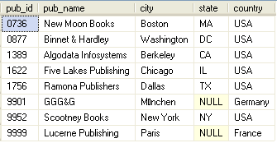
The Table cont.
This table has five columns of data. The number of columns remains constant regardless of how much data is in the table.
The table has
eight records –
the number of
records will go up and down as we add or delete data, but the nature of the data in each record is described and restricted by the data type of the column.

Slide 12

Note!
Do not use keywords and spaces in the column names.

Slide 13
Indexes
An index is an object that exists only within the framework of a particular table or view.
An index works much like the index does in the back of an encyclopedia; there is some sort of lookup (or “key”) value that is sorted in a particular way, and, once you have that, you are provided another key with which you can look up the actual information you were after.

Slide 14
Indexes cont.
Indexes fall into two categories:
  Clustered: Only one of these per table. The table on which the clustered index is based is physically sorted according to that index. If you were indexing an encyclopedia, the clustered index would be the page numbers; the information in the encyclopedia is stored in the order of the page numbers.
  Non-clustered: You can have many of these for every table. This kind of index points to some other value that will let you find the data. For the encyclopedia, this would be a keyword index at the back of the book.

Slide 15
Triggers
A trigger is an object that exists only within the framework of a table.
Triggers are pieces of logical code that are automatically executed when certain things, such as inserts, updates, or deletes, happen to your table.
Are mainly used for either copying data as it is entered or checking the update to make sure that it meets some criteria.

Slide 16
Constraints
Constraints confine the data in the table to meet certain conditions.

Slide 17
Filegroups
Filegroups provide an opportunity for fine-tuning performance by allowing you to move specific tables and indexes from one physical drive array to another.

Slide 18
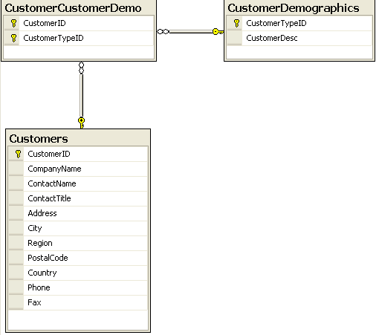
Diagrams
A database diagram is visual representation of the database design, including table, column names, and relationships.

Slide 19
Views
A view is used just like a table, except that it doesn’t contain any data of its own. Instead, a view is a preplanned mapping and representation of the data stored in tables.
The plan is stored in the database in the form of a query.

Slide 20
Stored Procedures
Generally an ordered series of Transact-SQL(the language used to query SQL Server) statements bundled up into a single logical unit.

Slide 21
User-Defined Functions
Similar to stored procedures, except:
  Can return a value of most SQL Server data types
  Can’t have “side effects” – they cannot reach outside the scope of the function (changing tables, sending emails, etc.)

Slide 22
Users and Roles
Users are the equivalent of logins.
Users belong to one or more role. Rights to perform certain actions in SQL server can then be granted directly to a user OR to a role to which one or more users belong.

Slide 23
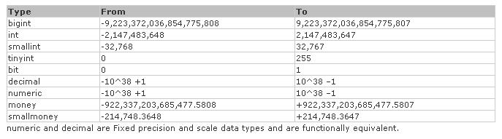
Data Types - Numeric

Slide 24

Approximate Numbers

Slide 25
Dates and Times
Data Type Name | Nature of the Data
DateTime | 1/1/1753 to 12/31/9999
DateTime2 | Supports larger data ranges than DateTime and with better precision. New with SQL Server 2008 and preferred over DateTime.
SmallDateTime | 1/1/1900 to 6/6/2079
Date | Stores date only from 1/1/0001 to 12/31/9999
Time | Stores only time data

Slide 26
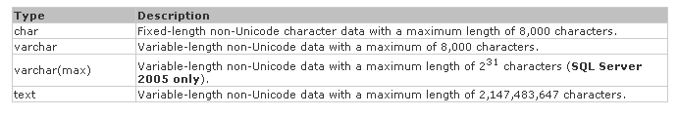
Character Strings

Slide 27
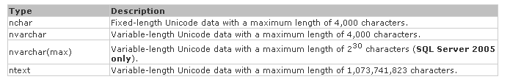
Unicode Character Strings

Slide 28
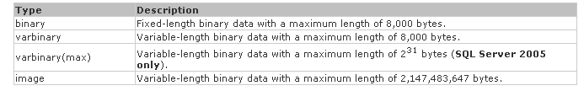
Binary Strings

Slide 29
Other data types
sql_variant: Stores values of various SQL Server-supported data types, except text, ntext, and timestamp.
timestamp: Stores a database-wide unique number that gets updated every time a row gets updated.
uniqueidentifier: Stores a globally unique identifier (GUID).
xml: Stores XML data. You can store xml instances in a column or a variable (SQL Server 2005 or later versions only).
cursor: A reference to a cursor.
table: Stores a result set for later processing.

Slide 30
Null data values
NULL is the “empty” value in SQL Server
The value of a column for a particular row is said to be null if it is not populated with data
Null means undefined

Slide 31
Rules for Naming
The name of the object must start with any letter as defined by the specification for Unicode 2.0.
The name can be up to 128 characters for normal objects and 116 for temporary objects.
Any names that are the same as SQL Server keywords or contain embedded spaces must be enclosed in double quotes or square brackets ([]).

